Slide 1
Outline
Understanding Local Cache and Working Offline
Copyright © 2008 Accenture All Rights Reserved.

Slide 2
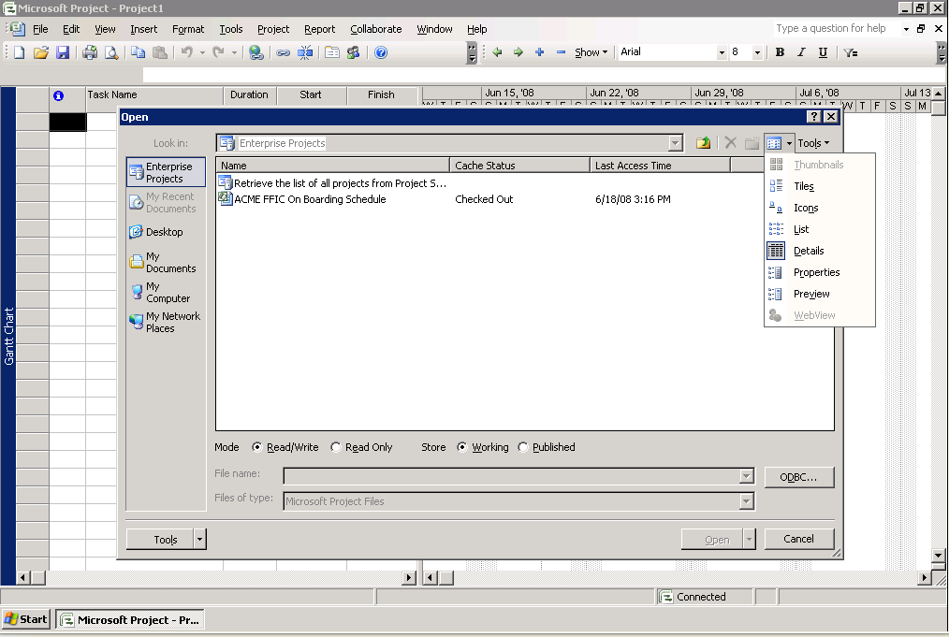
Understanding Queues and Local Cache: MSP 2007 Local Cache
Includes an active cache on the client side that reduces the amount of data sent over the network between the client and the server.
Portrays a seamless online/offline experience similar to caching in Outlook 2003.
Allows quick access with Project desktop over a wireless or slow connection.
Copyright © 2008 Accenture All Rights Reserved.

Slide 3
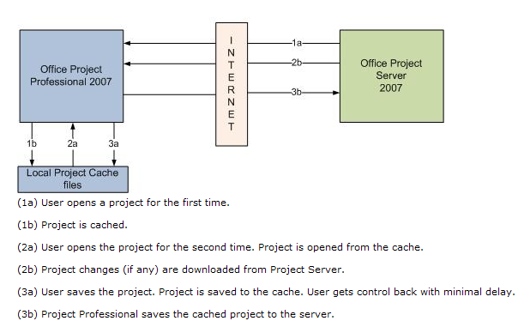
Understanding Queues and Local Cache: Local Cache Architecture
To view contents of the Local Cache, click Tools➔ Local Project Cache ➔ View Status.
Copyright © 2008 Accenture All Rights Reserved.
Notes:
Whenever you open or save Office Project Server 2007 projects, the operations go through the local project cache. The local project cache is a new feature that is always turned on. The main advantages of the local project cache are improved reliability (all changes are always saved to the cache first and then to the server) and better performance (once opened, projects are always loaded from the cache, and only changes are downloaded from the server).
In Microsoft Office Project Professional 2003, opening or saving a project plan from Project Server is very sensitive to network bandwidth, latency, and the size of the project plan. Each time a file is opened from or saved to Project Server 2003, the entire project file is downloaded to the client application or saved to Project Server.
In Microsoft Office Project Professional 2007, the local project cache feature enables efficient client-server connectivity. Whenever you use Office Project Professional 2007 to open a project from Microsoft Office Project Server 2007, the profile is saved as part of the local project cache. When the project is opened again from the server, the project is opened quickly, because only the changes made to the project (rather than the entire project) are downloaded from the server. Similarly, when you save a project to Office Project Server 2007, the project is first saved to the local cache and control is returned to the user. The local project cache then asynchronously saves the changes (rather than the entire project) to the server.

Slide 4
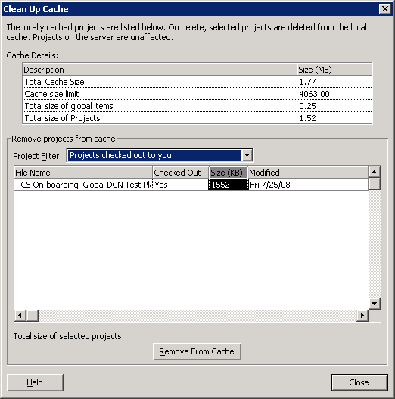
Understanding Queues and Local Cache: Common Issue with Local Cache
When opening project in MSP 2007, MSP may return an error message “This project cannot be opened in read-write mode because a previous check-in for this project is not complete”. This indicates one of two conditions:
  The project may be checked in on the server but the client application (MSP Pro) thinks the project is checked out, OR
  The project is marked as checked out on the server.
To resolve:
  Cleanup the cache:
    Tools➔Local Project Cache ➔ Cleanup Cache
  Use Project Filter for both Project Not Checked out to You and Projects Checked out to you
  If the project is displayed in the window, select it and click the Remove From Cache button
  If still unable to open, try checking in the plan from PWA
    Project Center➔ select Go To and select Check In My Projects.
Copyright © 2008 Accenture All Rights Reserved.

Slide 5
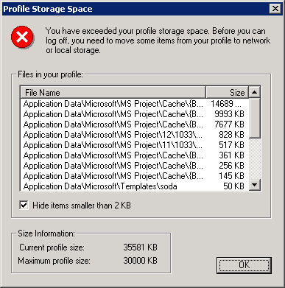
Understanding Queues and Local Cache: Common Issue with Local Cache
Perform regular cache cleanup to prevent error message below when logging off.
Copyright © 2008 Accenture All Rights Reserved.

Slide 6
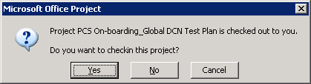
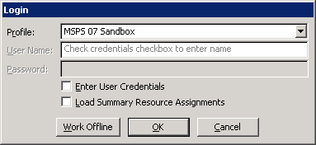
Working Offline
MSP 2007 enables you to work on a project plan when you are not connected to MSPS 2007.
To work offline:
  Load the latest version of the enterprise project into the Local Cache as an offline project but leave the project checked out.
  Click File➔ Close to close the project. Note: DO NOT check in the project
  Exit MSP Professional 2007.
To make offline updates to the work plan:
  Launch MSP 2007.
  In Login dialog box, select Regular Profile.
    (DO NOT select Computer)
  Click on Work Offline.
  Click File➔ Open.
Copyright © 2008 Accenture All Rights Reserved.

Slide 7
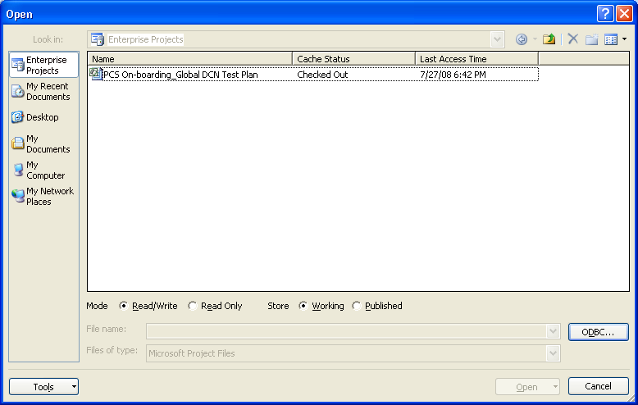
Working Offline
  MSP 2007 displays available project saved in Local Cache. Notice that Cache Status column shows the project as being Checked Out. In the Open dialog box, select the offline project, ensure Read/Write radio button is selected and click Open.
  Edit project as needed and click File➔ Save to save the offline project in the local cache.
  Click File➔ Close and select No to check in project.
  Exit MSP Pro 2007.
To synchronize offline changes to MSPS 2007
  Launch MSP Pro and log on the Server.
  Open offline project from cache.
  Click Save to synchronize changes.
  Publish changes.
  Click File➔ Close.
Copyright © 2008 Accenture All Rights Reserved.

